Slide 1
Software Testing
Course 6
{Dev}School Java

Slide 2
Introduction
It is the process used to identify the correctness, completeness and quality of developed computer software.
It is the process of executing a program/application under positive and negative conditions by manual or automated means. It checks for the:
Specification
Functionality
Performance
”Testing can show the presence of bugs but never their absence” - Dijkstra

Slide 3
Objectives
Uncover as many as errors (bugs) as possible in a given product.
Demonstrate a given software product matching its requirement.
Validate the quality of a software testing using the minimum cost and effort.
A necessary part of every test case is a description of the expected result.
Error, Bug, Fault & Failure
Error: it is a human action that produces the incorrect result that produces a fault
Bug: the presence of error at the time of execution of the software
Fault: state of software caused by an error
Failure: Deviation of the software from its expected result. It is an event.

Slide 4

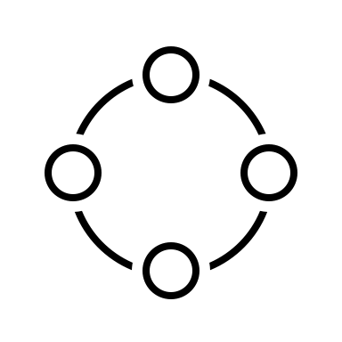

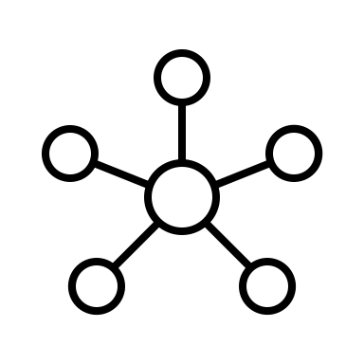



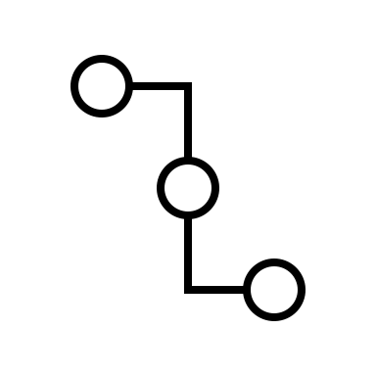
Test automation pyramid
Security
Functional
Integration
Unit
Validation
Performance
comprehensiveness
costs

Slide 5
Terminology
Unit tests
speed
unity
zero external dependencies (no spring context, db connections)
generates code coverage
Integration tests
slower
covers multiple application components
includes test-controlled dependencies (spring context, mocked databases)
Functional tests
application is running in a known environement
usually split based on scope (ui integration, performance, security assessment)
interaction with external dependencies is validated

Slide 6
Unit tests – Junit & Mockito & Best practices
test classes location: src/main/test
package of test classes should be the same package as the class where the code under test is located
maven will execute tests using surefire plugin under test goal for classes: **/Test*.java **/*Test.java **/*Tests.java **/*TestCase.java
JUnit annotation
@Test | signals a method as being a unit test
@BeforeAll/@BeforeEach | signals a method to be run before all/each unit test (beforeAll – static method)
@AfterAll/@AfterEach | signals a method to be run after all/each unit test (afterAll – static method)
@Disabled | signals a test is intended to be skipped
@ExtendWith | registers extensions required by different frameworks (e.g. MockitoExtension.class)
Mockito annotations
@Mock | mark a field of the test class a being a mock
@Spy | mark a field of the test class a being a spy – allowing to override behaviour
@InjectMocks | inject dependencies based on found constructors and existing mocks
Unit testing,
Shall we?

Slide 7
Test Driven Development – TDD
1. Write tests first
🤨
2. But tests will fail
🧐
3. Code to fix tests
🤔

Slide 8
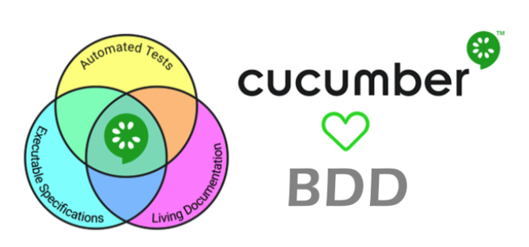
Behavior Driven Development Cucumber And Gherkin
Notes:
https://cucumber.io/
It is a BDD testing tool

Slide 9
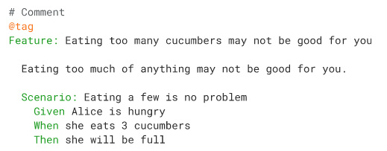
Gherkin

Slide 10


Cucumber - Expressions

Slide 11
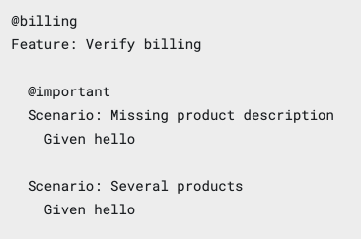
Cucumber – More info
Hooks:
- Before: run before the first step of each scenario
After: run after the last step of each scenario, even when the step result is failed, undefined, pending or skipped.
Tags: are a great way to organize your features and scenarios

Slide 12
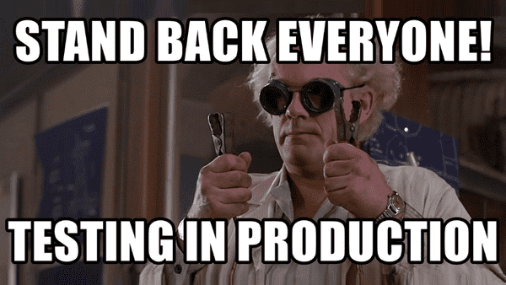
Tests are important

